Slide 1
Student Performance Analysis
Subtitle:
An Analysis of Factors Influencing Student Scores
Name : Gowtham.K
Batch Name : Data Science & Data Analysis
Guided By :
Date :

Slide 2
INTRODUCTION:
Project Objective :
To analyze a dataset of student performance and identify key factors that influence academic scores.
Problem Statement:
This analysis explores the relationship between various demographic and social factors and student performance in Math, Reading and Writing Scores.

Slide 3
DATA UNDERSTANDING:
Data Description :
The dataset contains 1000 rows and 8 columns of student information
Data Source :
The data was loaded from a CSV file named student_performance_knn.csv.
Key variabels :
Categorical :
Gender, Race & Ethnicity, Parental Level of Education, Lunch, Test Preparation Course.
Numerical :
Math Score, Reading Score, Writing Score.

Slide 4
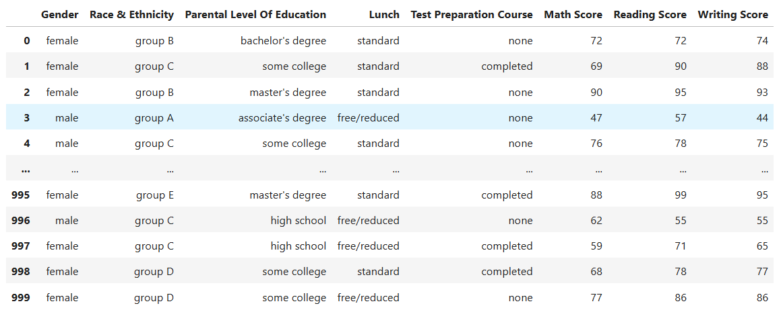
DATASET

Slide 5
DATA CLEANING:
Data Cleaning Explanation:
Explain that data cleaning is a necessary step to ensure the data is accurate and reliable for analysis.
Missing values:
The Lunch column had 25 null values

Slide 6
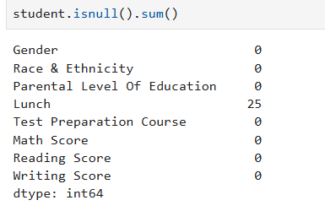
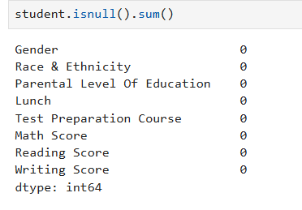
Missing value Handling:
The missing values were handles using mode imputation because Lunch is a categorical variable
Before Null Values:
After Remove Null Values:

Slide 7
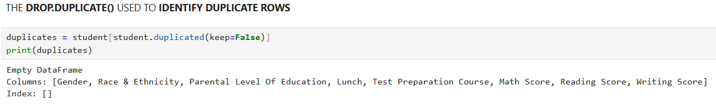
HANDLING DUPLICATE :
Duplicate Check :
A Check for duplicate rows was performed on the dataset
Result :
No dulicates were found in dataset

Slide 8
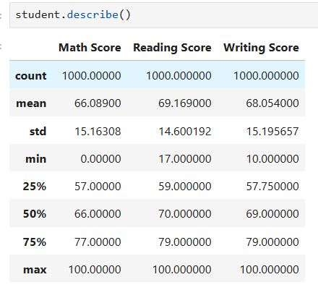
DISCRIPTIVE STATISTICS:
Descriptive Analysis:
Provide a high-level overview of the descriptive statistical for the dataset , such as mean , median, and mode for the scores

Slide 9
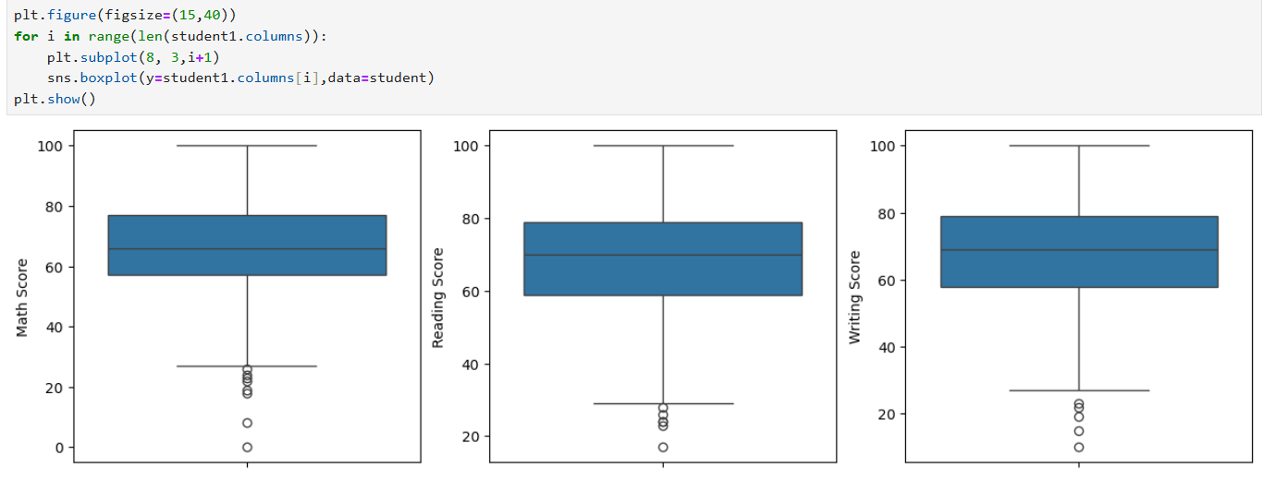
CALCULATE AND IDENTIFY OUTLIERS
TEHY ABOVE THE THREE CHATS WHICH MATH SCORE,READING SCORE AND WRITING SCORE
THIS ARE SCORE COLUMNS SO WE CAN'T REMOVE THE OUTLIERS BECAUSE THE SCORES ARE DIFFRENSE BETWEEN EACH STUDENT
WHEN WE REMOVE THE OUTLIRES MEANS IT'S AFFECT THE ANALYSIS

Slide 10
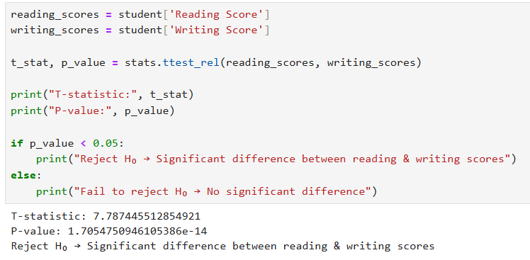
HYPOTHESIS TESTING
PAIRED T-TESTING:
A paired t-test to compare two sets of scores: reading and writing. It checks if the difference between the two sets is statistically significant by calculating a t-statistic and a p-value.
INSIGHTS:
THIS CODE IS A TWO-SAMPLE T-TEST COMPARING MALE AND FEMALE MATH SCORE
P-VALUE IS FAR BELOW 0.05 - REJECT HYPOTHESIS MEAN
THERE IS A SIGNIFICANT DIFFERENCE BETWEEN MALE AND FEMALE MATH SCORES

Slide 11
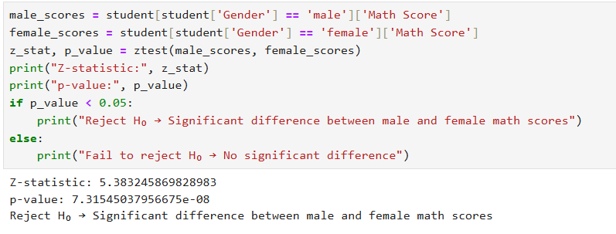
TWO-SAMPEL Z-TEST
A two-sample z-test to compare the math scores of male and female students. The code first separates the math scores for each gender, then uses the ztest function to calculate the z-statistic and p-value.
INSIGHTS:
MALE AND FEMALE STUDENTS HAVE NOTICEABLY DIFFERENT AVERAGE MATH SCORES
THE HIGH Z-STATISTIC (5.38) SHOWS THE DIFFERENCE IS STRONG AND UNLIKELY DUE TO CHANCE
P-VALUES (7.31e-08) IS FAR BELOW 0.05,MEANING THE DIFFERENCE
THE NULL HYPOTHESIS (NO DIFFERENCE) IS REJECTED WITH HIGH CONFIDENCE

Slide 12
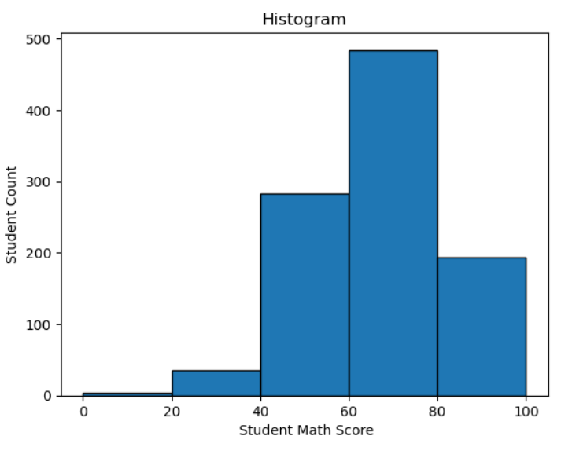
UNIVARIATE ANALYSIS:
HISTOGRAM: This is a histogram showing the distribution of student math scores. The x-axis represents the student math score, and the y-axis shows the number of students
INSIGHTS:
Then Most Of Student Between 60 To 80 In Math Score
Very Few Student Scored Below 40 or Above 80 ,In The Middle Range
There Are Very Few Student 0 To 20 That Is Extremely Low Performance In Math Score To Need For Special Learning In Math Score

Slide 13
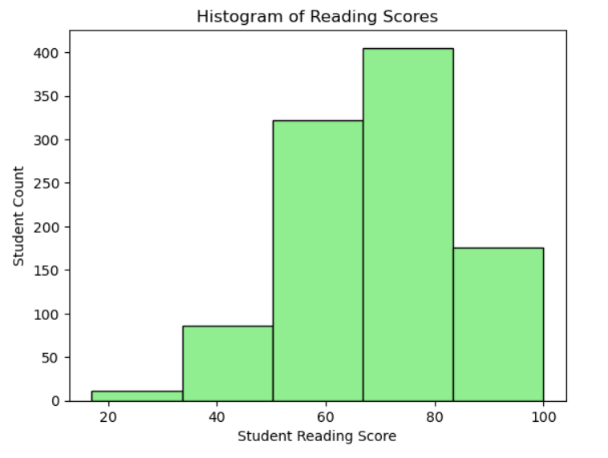
Histogram of Reading Score:
This is a histogram showing the distribution of student reading scores. The x-axis represents the student reading score, and the y-axis shows the number of students
INSIGHTS:
THEN MOST OF STUDENT SCORED BETWEEN 70 TO 80 IN READING SOCRE
VERY FEW STUDENT SCORED BELOW 50 OR ABOVE 80, IN THE MIDDLE RANGE OF READING SCORE
THERE ARE VERY FEW STUDENT BELOW 40 THAT IS EXTREMELY LOW PERFORMANCE IN READING SCORE

Slide 14
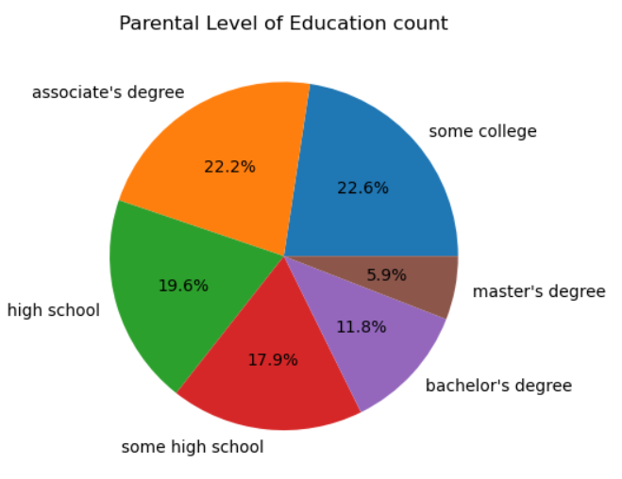
PIE CHART
This is a pie chart titled "Parental Level of Education count," which shows the distribution of the highest level of education attained by a student's parent(s).
INSIGHTS:
THE MOST OF THE PERENT ASSOCIATE'S DEGREE (22.2%) MAKEUP ALMOST HA;F OF THR STUDENT'S PARENTAL EDUCATION LEVELS COMBINED
BACHELOR'S DEGREE(11.8%) IS LESS COMMON,AND MASTER'S DEGREE(5.9%) IS THE LEAST COMMON PARENTAL LEVEL EDUCATION LEVEL

Slide 15
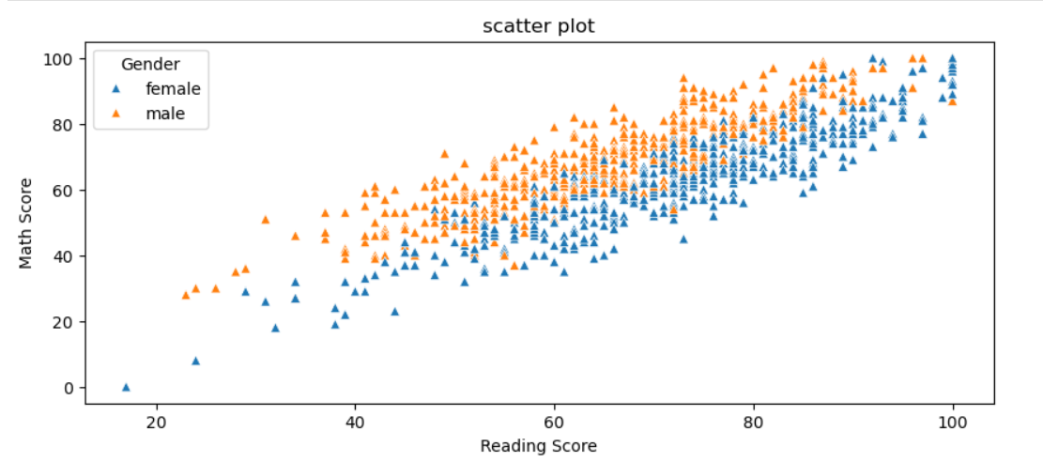
BIVARIANT ANALYSIS
SCATTER PLOT:
Scatter plot showing the relationship between students' math scores and reading scores, with a distinction made for gender.
INSIGHTS:
THIS SCATTER PLOT OF READING SCORE VS MATH SCORE BY GENDER
AS READING SCORE INCREASE, MATH SCORE ALSO TEND TO INCREASE FOR BOTH GENDERS.
MOST OF FALL BETWEEN READING SCORE OF 50-90 AND MATH SCORE ALSO 50-90
BOTH ARE COMMON PERFORMANCE RANGE

Slide 16
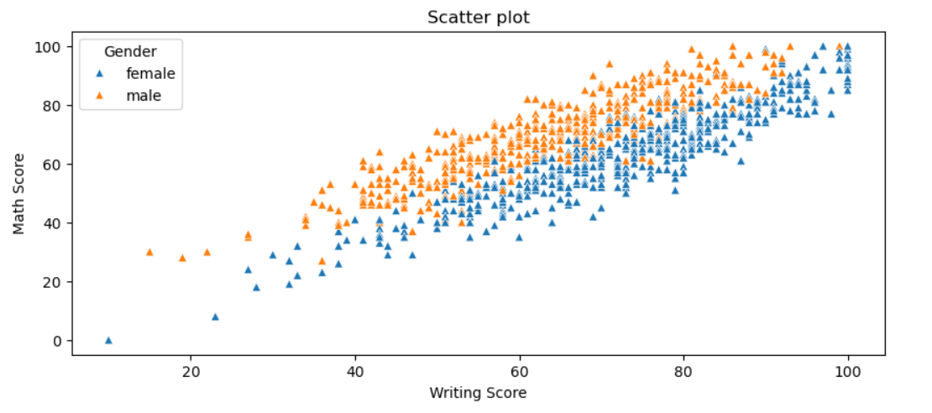
SCATTER PLOT
This is a scatter plot showing the relationship between students' writing scores and math scores, with data points separated by gender.
INSIGHTS:
STUDENTS WITH HIGHER WRITING SCORES ALSO HAVE HIGHER MATH SCORES
MALE STUDENTS (ORANGE) TEND TO CLUSTER SLIGHTLY HIGHER IN MATH SCORE COMPERS TO FEMALE AT SIMILAR WRITING SCORES
MOST STUDENT SCORE BETWEEN 40-100 IN BOTH WRITING AND MATH,STUDENT IN THE LOW-SCORE RANGE
A FEW STUDENT HAVE LOW MATH SCORES

Slide 17
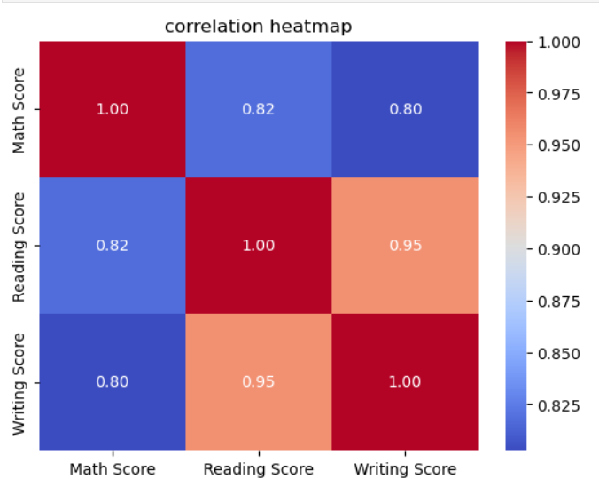
CORRELATION HEATMAP
This is a correlation heatmap that shows the relationships between three different scores: Math Score, Reading Score, and Writing Score.
INSIGHTS:
THIS CORRELATION HEATMAP TO REPRESENT TO THREE SCORES ARE HIGHLY POSITIVELY CORRELATED (ABOVE 0.80)
READING AND WRITING SCORES HAVE THE STRONGEST RELATIONSHIP(0.95)
MATH SCORE HAS SLIGHTLY LOWER CORRELATION WITH READING (0.82) AND WRITING (0.80) COMPARED TO INTERRELATION

Slide 18
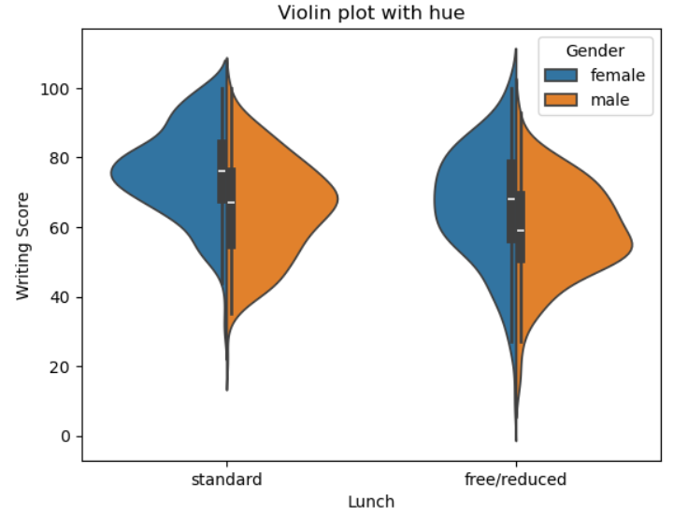
MULTIVARIET ANALYSIS
VIOLIN PLOT:
This is a violin plot with hue that displays the distribution of writing scores based on two variables: Lunch type and Gender.
INSIGHTS:
THIS VIOLIN PLOT REPRESENT TO STUDENT WITH STANDARD LUNCH BASE GENDER
STUDENT WITH STANDARD LUNCH GEMERALLY HAVE HIGHER WRITING SCORES THEN THOSE WITH FREE/REDUCED LUNCH
THE MEDIAN WRITING SCORE IS HIGHER FOR STANDARD LUNCH STUDENTS IN BOTH GENDERS

Slide 19
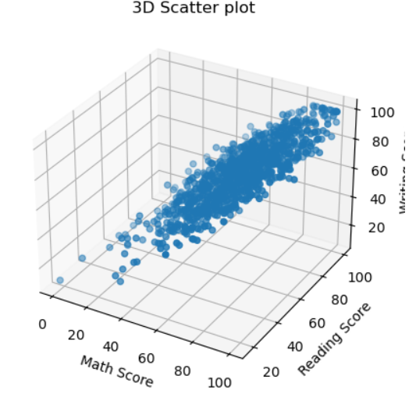
3D SCATTER PLOT:
This is a 3D scatter plot showing the relationship between students' scores in three subjects: Math, Reading, and Writing.
INSIGHTS:
MATH,READING,AND WRITING SCORES ARE ALL CLOSELY RELATED TO HIGH DCORES IN ONE SUBJECT OFTEN MEAN HIGH SCORES IN THE OTHERS
HIGH PERFORMERS MANY STUDETN ARE CONCENTRATE IN THE UPPER RANGE (70-100) ACROSS ALL THREE SUBJECTS

Slide 20
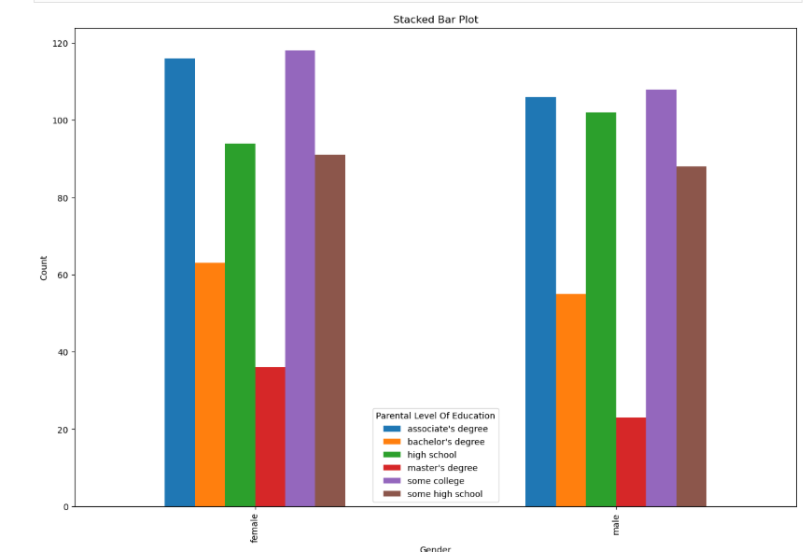
GROUPED BAR PLOT
This is a grouped bar chart , titled "Parental Level of Education count," which shows the number of male and female students categorized by their parents' highest level of education.
INSIGHTS:
ASSOCAIATE'S DEGREE AND SOME COLLEGE ARE THE TOP EDUCATION LEVELS FOR BOTH MALE AND FEMALE STUDENT
MOST PARENTAL EDUCATION LEVELS FALL BEWTWEEN SOME HIGH SCHOOL AND ASSOCIATE DEGREE, WITH FEWER AT THE EXTREMES (LOW OR HIGH).

Slide 21
CONCLUSION AND RECOMMENDARION
Key Findings & Insights:
Students who completed the test preparation course generally achieved higher scores in all three subjects.
Lunch type (standard vs. free/reduced) showed a clear impact on performance, with standard lunch students performing better on average.
Gender differences were observed: on average, females performed slightly better in reading and writing, while males scored marginally higher in math.

Slide 22
RECOMMENDATION:
Schools should encourage participation in test preparation programs, as they significantly improve outcomes.
Provide additional academic support and resources to students receiving free/reduced lunch to help close performance gaps.
Introduce targeted interventions:
Support boys in reading/writing through literacy initiatives.
Provide extra practice for girls in math to balance performance.

Slide 23
Future Work / Next Steps:
Conduct deeper analysis of socioeconomic factors beyond lunch type to understand external influences.
Investigate teaching strategies that could reduce performance gaps between groups.
Extend analysis with a larger or more recent dataset for better generalization.

